Slide 1
JSON
Client
meta
function loadJSON(json)
{
$.ajax({
method: "POST",
url: "update_user.php",
data: { data: json},
dataType: "json"
})
}
json = {"nom":"Carlos","cognoms":"de Andrea","username":"carlinho",
"password":"e404b253da46751a429ac447b2e893f3",
"email":"viva_uruguay@gmail.com","user_id":"3452","mode":"update"}

Slide 2
JSON
Servidor
ajax.php
$data = $_REQUEST['data'];
$info = JSON_decode($data,true);
if ($info['mode'] == "update"){ //Diferents tipus
update_user_data($info);
} else if ($info['mode'] == "register"){
register_user($info);
}
users.php
function update_user_data($data){
$sql = "UPDATE `usuaris` SET `username` = '".$data['username']."',
`password` = '".$data['password']."', `nom` = '".$data['nom']."',
`cognoms` = '".$data['cognoms']."', `email` = '".$data['email']."'
WHERE `usuaris`.`user_id` = ".$data['user_id'].";";
mysql_query($sql);
}

Slide 3
XML
Client
/*Petició del Client*/
function showHabitacio(str) {
xmlhttp = new XMLHttpRequest();
xmlhttp.onreadystatechange = function() {
if (xmlhttp.readyState == 4 && xmlhttp.status == 200) {
parser=new DOMParser();
xmlDoc=parser.parseFromString(xmlhttp.responseText);
txt= /*Construïm la taula html*/ document.getElementById('txtHint').innerHTML=txt;
}
}
xmlhttp.open("GET","getreserva.php?habitacio="+str,true);
xmlhttp.send();
}
header

Slide 4
XML
Servidor
/*Consulta de la taula i construcció d’un XML*/
$xml = "<?xml version=\"1.0\" encoding=\"UTF-8\"?>";
$xml .= "<RESERVES>";
if(mysql_num_rows($result)>0)
{
while($result_array = mysql_fetch_assoc($result))
{
$xml .= "<RESERVA>";
foreach($result_array as $key => $value)
{
$xml .= "<".strtoupper($key).">";
$xml .= "$value";
$xml .= "</".strtoupper($key).">";
}
$xml .= "</RESERVA>";
}
}
$xml .= "</RESERVES>";
echo $xml;
getreserva.php

Slide 5

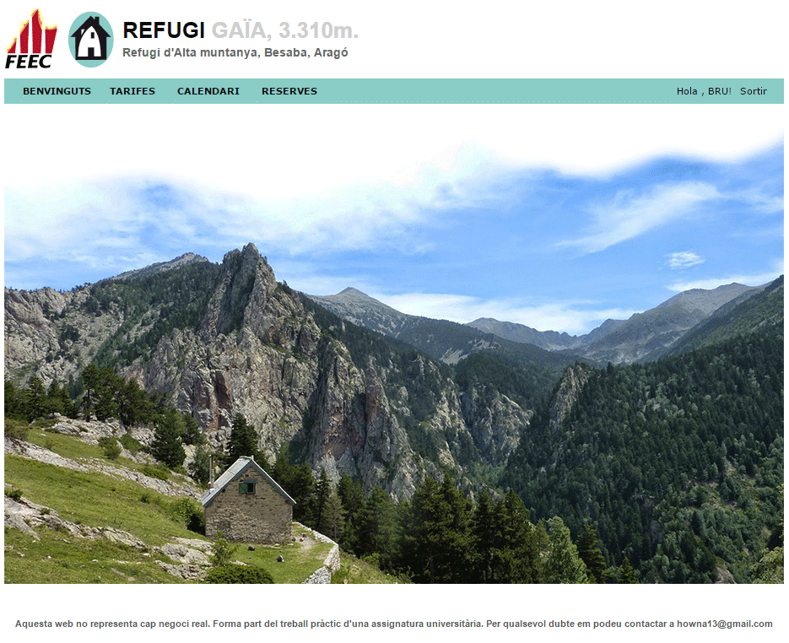
COOKIES
user.php
<img onclick="changeFoc()" class="centered" src="img/flama.png" alt="Refugi Gaia 2310 m">
header
function changeFoc(){
valor = getValueCookie("foc");
var now = new Date();
var time = now.getTime();
time += 60 * 15; //15 min
now.setTime(time);
if(valor == "true"){
document.cookie="foc=false; expires=" + now.toUTCString();
$("#feec").attr('src', 'img/feec.jpg');
} else{
document.cookie="foc=true; expires=" + now.toUTCString();
$("#feec").attr('src', 'img/feec_onfire.gif');
}
}

Slide 6
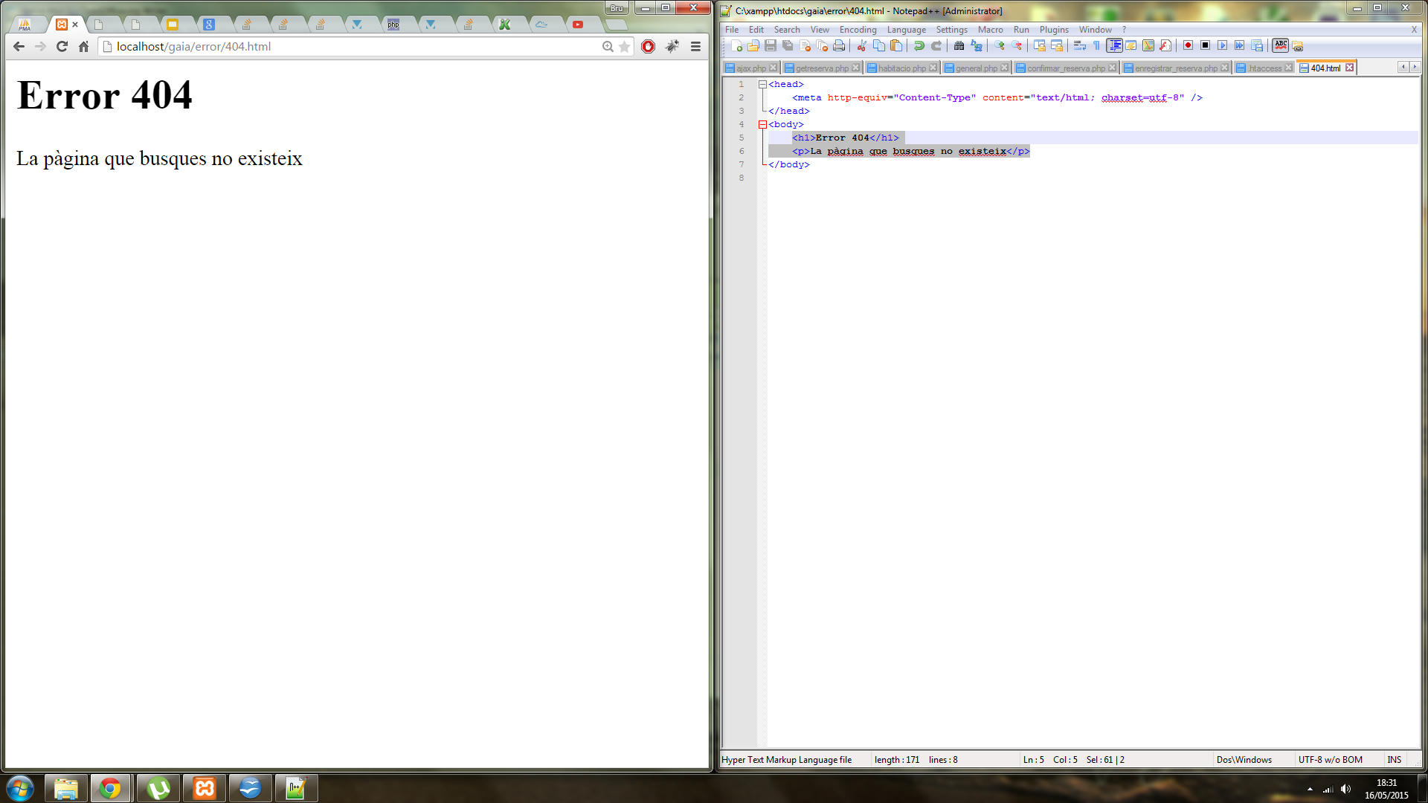
SESSION
login.php
if(empty($_POST) === false){
$username = $_POST['username'];
$password = $_POST['password'];
$user_id = login();
$_SESSION['user_id'] = $user_id;
header('Location: index.php');
exit();
}
ERRORS
.htaccess
ErrorDocument 404 /error/404.html
404.html
<h1>Error 404</h1>
<p>La pàgina que busques no existeix</p>

Slide 7
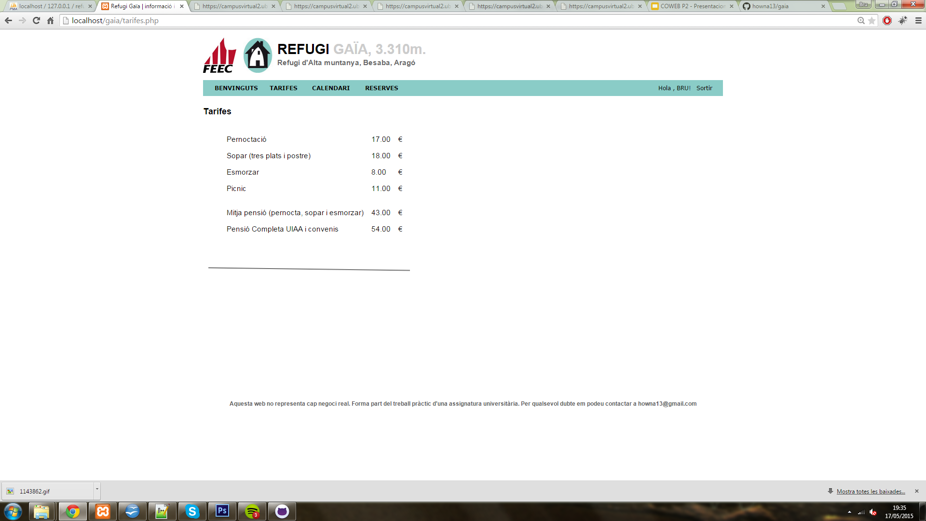
CANVAS
tarifes.php
<canvas id="myCanvas" width="390" height="100"></canvas>
<script>
var c=document.getElementById("myCanvas");
var ctx=c.getContext("2d");
ctx.moveTo(10,50);
ctx.lineTo(390,50);
ctx.stroke();
</script>

Slide 8
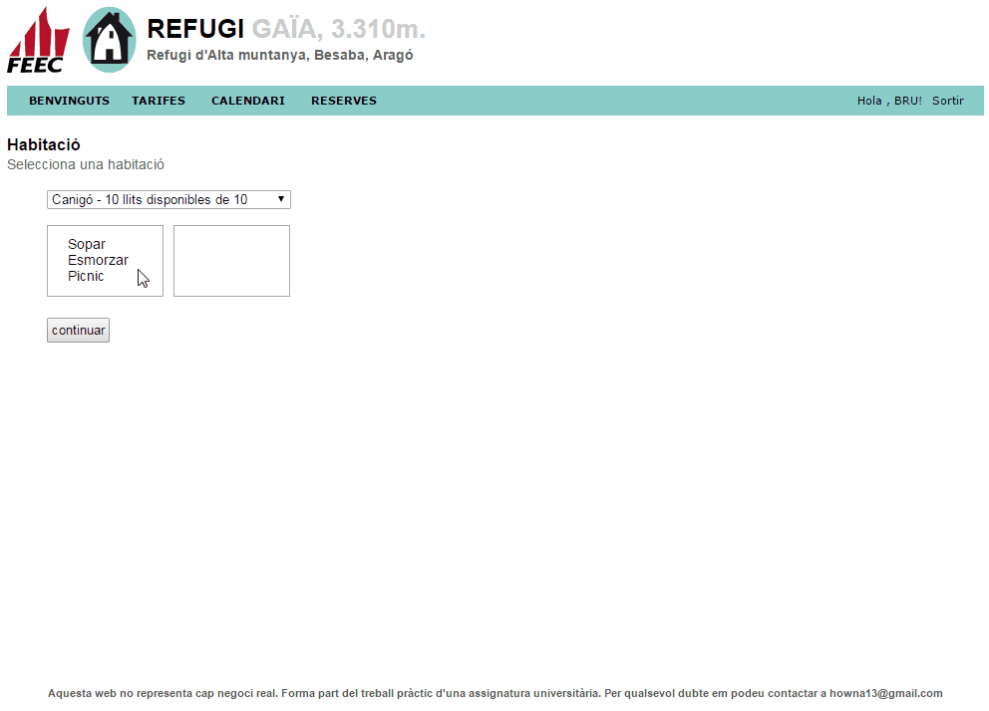
DRAG & DROP
habitacio.php
<div id="div1" ondrop="drop(event)" ondragover="allowDrop(event)">
<ul>
<li id="sopar" draggable="true" ondragstart="drag(event)"
style="margin-left:10px;">Sopar</li>
<li id="esmorzar" draggable="true" ondragstart="drag(event)"
style="margin-left:10px;">Esmorzar</li>
<li id="picnic" draggable="true" ondragstart="drag(event)"
style="margin-left:10px;">Picnic</li>
</ul>
</div>
<div id="div2" ondrop="drop(event)" ondragover="allowDrop(event)">
<ul></ul>
</div>

Slide 9
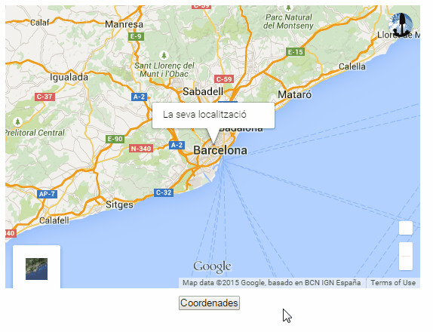
GEOLOCATION
user.php
<script>
var x = document.getElementById("coordenades");
function getLocation() {
if (navigator.geolocation) {
navigator.geolocation.getCurrentPosition(showPosition);
} else {
x.innerHTML = "Geolocation is not supported by this browser.";
}
}
function showPosition(position) {
$("#boto").remove();
$("#coordenades").fadeIn("slow");
x.innerHTML = "Latitude: " + position.coords.latitude +
"<br>Longitude: " + position.coords.longitude;
}
</script>

Slide 10
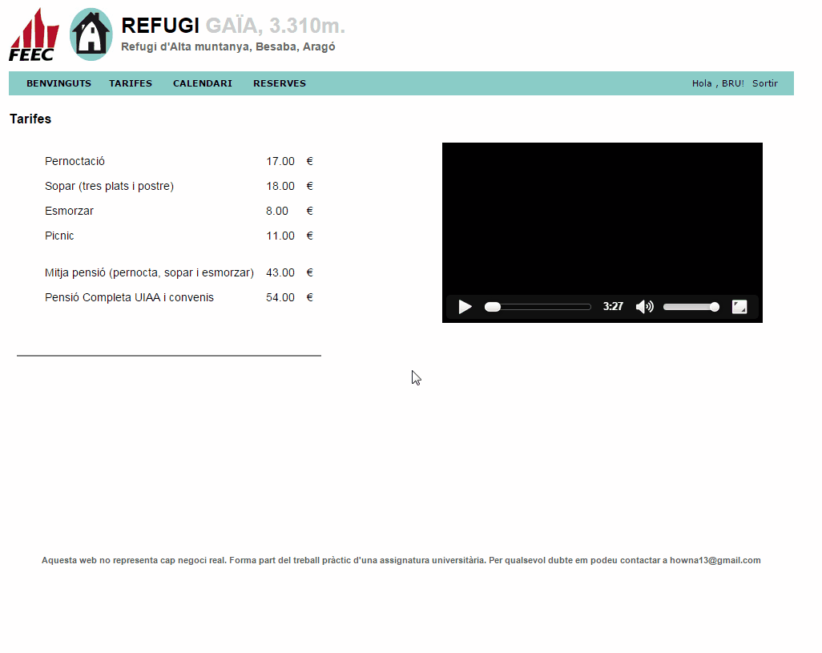
VIDEO
tarifes.php
<video style="float:right;margin-right:39px;" width="400" controls>
<source src="video/video.mp4" type="video/mp4">
Your browser does not support HTML5 video.
</video>

